Slide 1
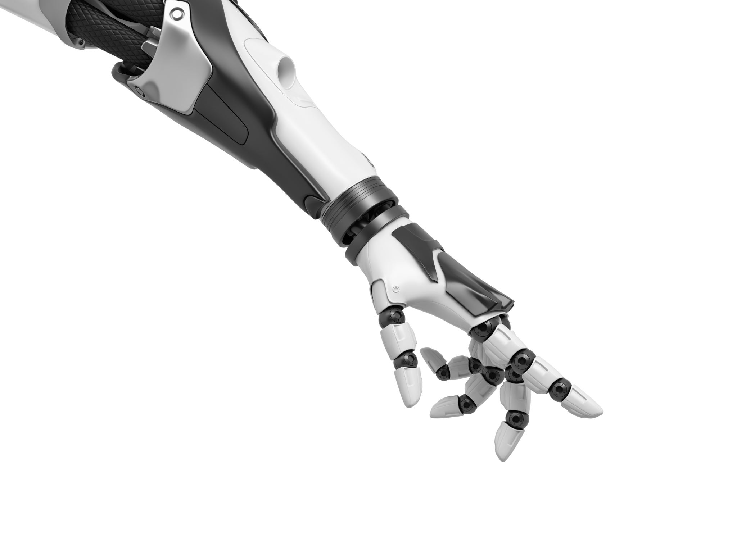
Use Cases for FYP

Slide 2
Title + Description of Project
Title = Technology & The Body: An inexpensive, non-invasive prosthetic arm
Description = Developing an inexpensive prosthetic arm that uses non-invasive sensors to measure muscles stimulation for opening and closing the hand

Slide 3
Invasive VS Non-Invasive
Invasive Sensors – Surgically implanted to directly interface with the nervous system
Non-Invasive – Do not require surgery & placed on the skin to detects signal from muscles

Slide 4
Inexpensive Prosthetic Arm
“— Wrist Disarticulation
Wrist disarticulation amputation — also referred to as below-elbow amputation — involves the removal of three bones in the forearm: the radius, ulna, and humerus, as well as all the soft tissue and tendons connected to them. However, the muscles, ligaments, and skin above the amputation point usually stay intact. Wearing a device with a prosthetic hand will offer more control over the remaining limb and an increased range of motion.” - https://primecareprosthetics.com/blog/what-you-should-know-before-getting-a-prosthetic-arm
Cost = “ up to $10,000 for a functional prosthetic arm that ends in a split hook, and up to $20,000-$100,000 or more for an advanced myoelectric arm, controlled by muscle movements, with a functioning artificial hand.” - https://health.costhelper.com/prosthetic-arms.html
https://openbionics.com/hero-arm-covers/ = alternative prosthetics

Slide 5






Slide 6
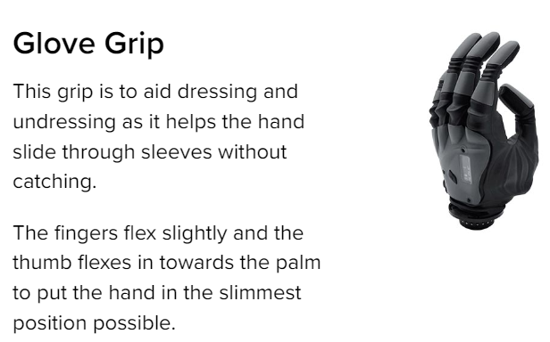
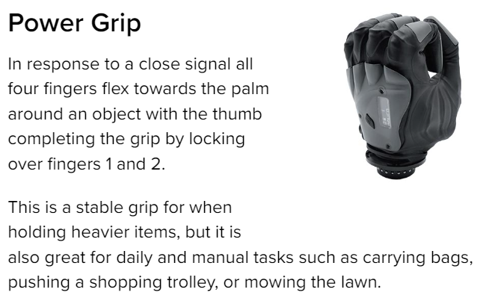
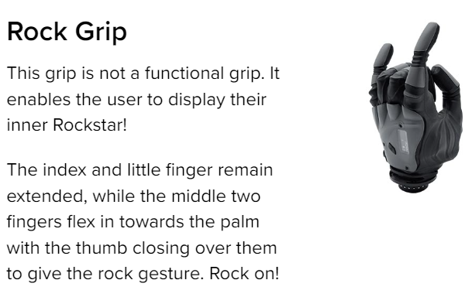
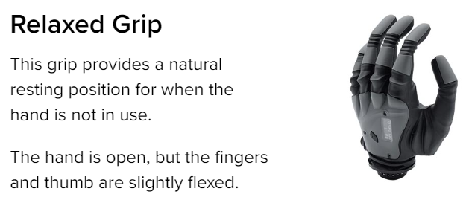
Other Companies
https://www.covvi.com/

Slide 7
Current Market
https://pubmed.ncbi.nlm.nih.gov/35085179/

Slide 8
Aspects to consider
Grip strength
Open/close speed
Power usage
Touch Screen Compatible
Arm Weight
Maximum Weight Limit
Waterproof
Durability (Weather)
Durability ( Temperature)
Durability (Fall Damage)

Slide 9
Other Possible Use cases

Slide 10
Demonstration of how the Hand Functions
Using EMG sensor , this arm could be used to demonstrate how ligaments and tendons contract and relax muscles to open and close the hand
Could be used in class rooms and colleges

Slide 11
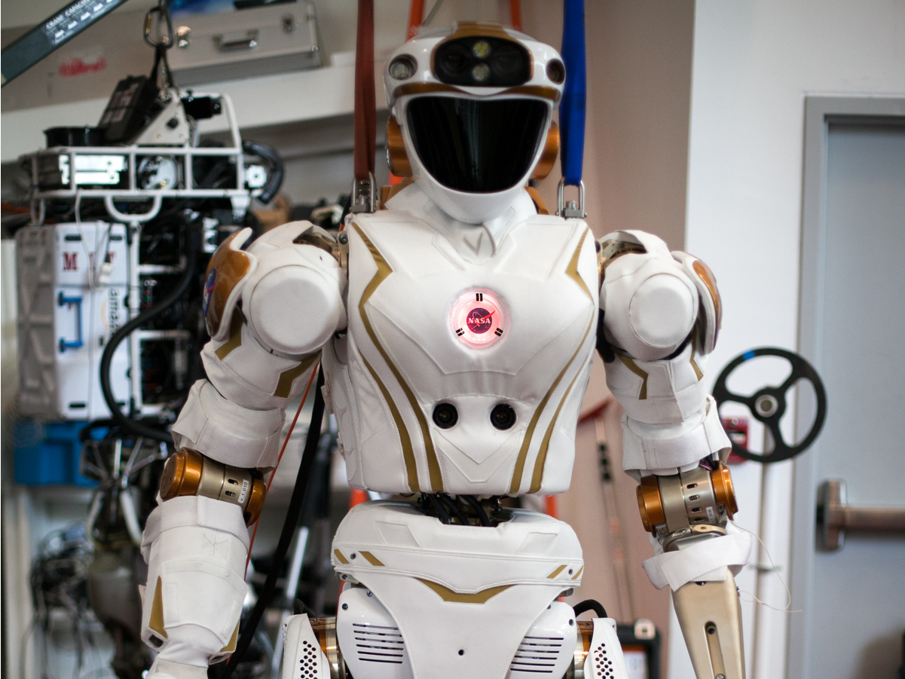
Remote Control devices
Unmanned space missions (ISS/ Mars)
Unmanned ocean missions (deep sea exploration)
Hazardous Environment Operations
Disaster Relief + Rescue
Manufacturing & Warehouse

Slide 12

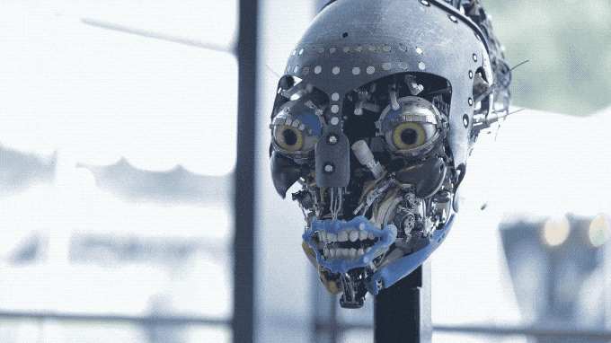
Animatronics

Slide 13
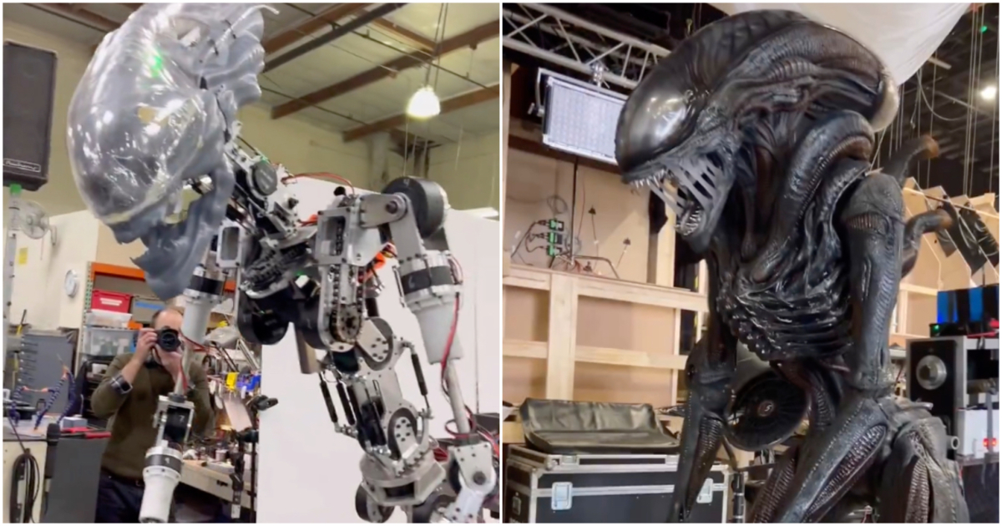
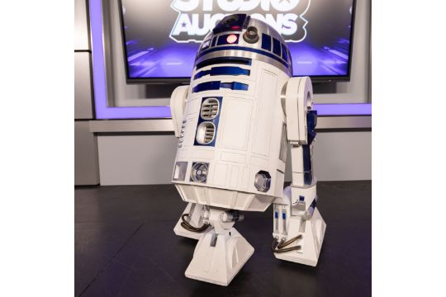
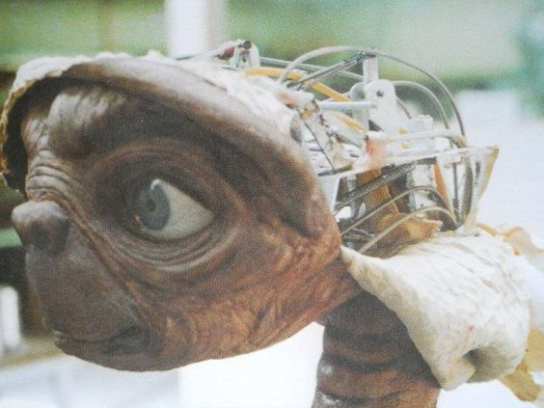
Movie Props

